Slide 1


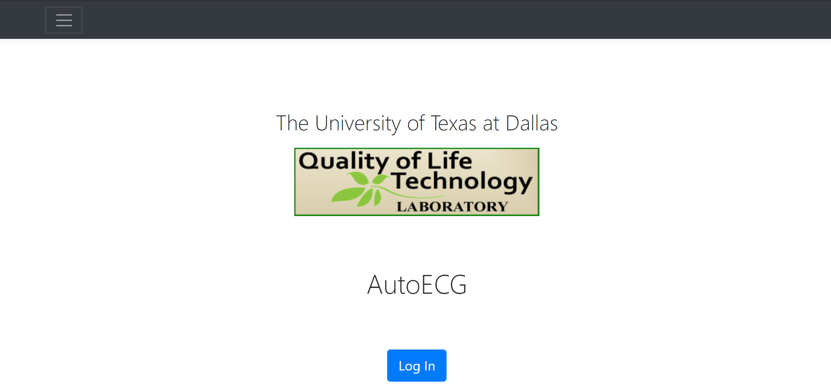
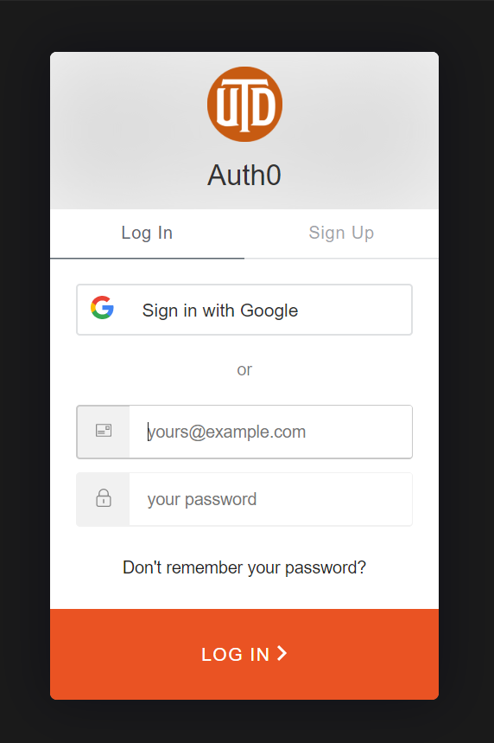
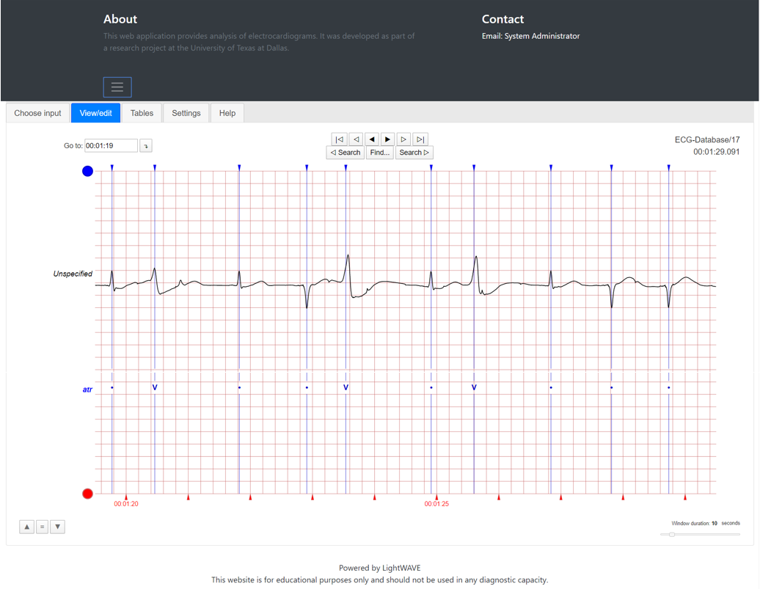
UTD-QLTL: Personalized app utilizing ECG sensor to monitor arrythmia
Jace Baker Gabriel Balanov Danielle Faris Lirit Fuksman Evelyn Wong
Goal: Create an interface for arrythmia patients and healthcare providers to continuously monitor irregular episodic heartbeat
Approach
React Native cross-platform app
LightWave Python visualization tool
Python web application
Auth0 authentication API backend
SQL Server database
Features
Mobile app: transmit ECG signal to the machine learning algorithm in the cloud and receive notification
Web app:
End-users view visualized signal in LightWave tool
Administrator changes user roles in the admin dashboard

